Slide 1
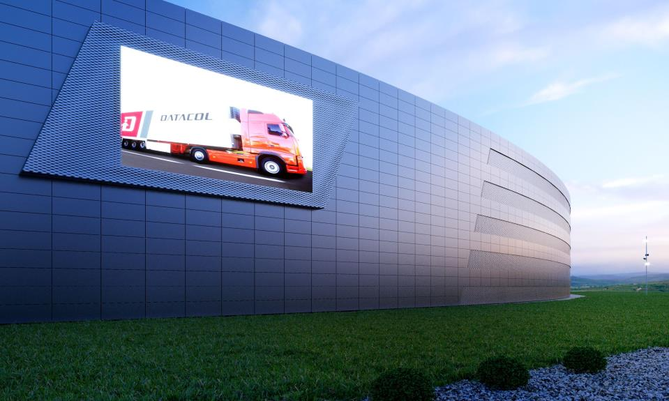
introducing avancis skala solar façade panels
Jochen Weick, AVANCIS GMBH
FOR INTERNAL USE ONLY

Slide 2
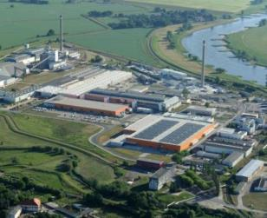
ABOUT AVANCIS
  German Manufacturer of CIGS thin-film modules
  More than 25 years CIGS knowledge as PV Pioneer
  (Arco Solar, Siemens)
  Founded in 2006 as JV of Shell and Saint-Gobain, since 2014
  part of CNBM group
  ~ 300 employees in Torgau near Leipzig (head quarters &
  production) and Munich (R&D)
  Production facility for the European market: Torgau
  Really engineered and produced in Germany (possibility of
  doing factory tours for interested customers)

Slide 3
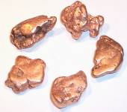
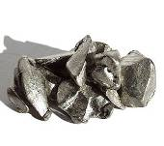
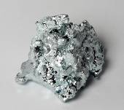
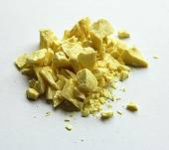
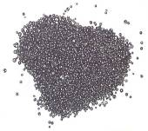
About CIGS technology – what´s the advantage?
  CIS - equivalent to CIGS - is the most efficient thin-film technology that is currently being
  introduced as a spearheading technology to China
  No silicon inside: Copper (Co), Indium (In), Gallium (Ga), Sulphur (S), Selenium (Se)
  Thin-film technology because layer thickness of CIS is around 1/100 of crystalline silicon (C-Si)
  Less materials and energy needed for production
  Environmental friendly, vertically integrated production

Slide 4
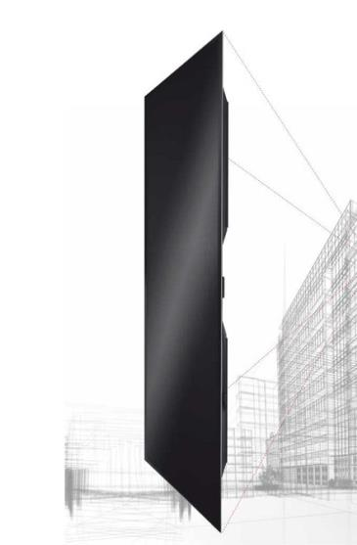
Avancis bipv product powermax skala
  What is the main advantage of AVANCIS SKALA façade panels?
  The SKALA panel is uniform black, no solar cells are visible
  The SKALA panel has no frame (architects don’t like frames)
  The SKALA panel has no mechanical clamping / brackets on the front glass
  It is mounted by an invisible metal rail system on the backside of the panel
  But: it can be mounted from the front side with the patented “W”-Clamp, so you can easily remove the panel in case of a failure
  Can be easily integrated as an ventilated façade, also in combination with any other façade cladding material

Slide 5
Avancis bipv product powermax skala
  What is the specific USP of Powermax SKALA
  The uniformity of black colour, is higher by a special production process with color detectors who screens the surface color of the solar panel. Just the panels with limited color variation is A+ quality and base for SKALA
  Only SKALA is undergoes various test procedures according the “General Building Approval”. With these tests Avancis guarantees product safety also with vertical mounting on the façade without any mechanical holder. So SKALA has an “Accordance Label”
  SKALA Black is the base for a product platform, see following page

Slide 6
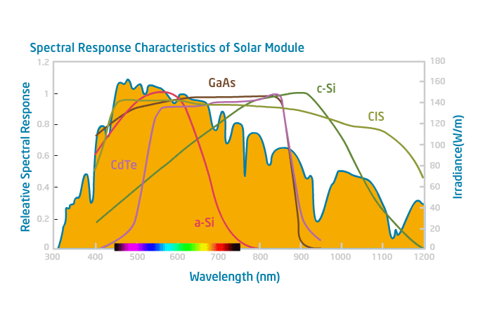
Spectral performance of CIGS – the unbeaten advantage to c-Si modules
  High energy yield due to spectral response -> More kWh per kWp
  Broadest light spectrum of all PV technologies -> Excellent performance under all-weather-conditions
  (bright sunlight / cloudy skies / fog / diffuse light at sunrise/sunset
Relative Spectral Response
Wavelength (nm)

Slide 7
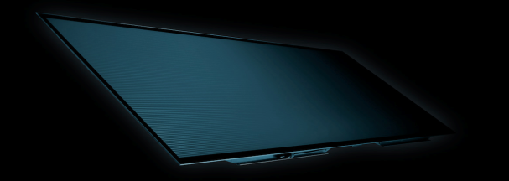
premium brand in the cigs technology
  PowerMax® SKALA electrical features
  No PID effect
  Any inverter possible (without transformer), including string inverters

Slide 8
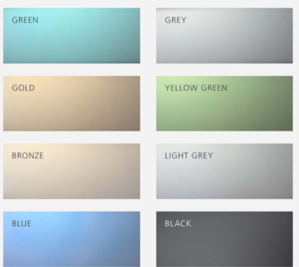
design flexibility with additional options
SIZE COLOR
… more to come like black-anthracite supermatt

Slide 9
TECHNICAL
INTEGRATION

Slide 10
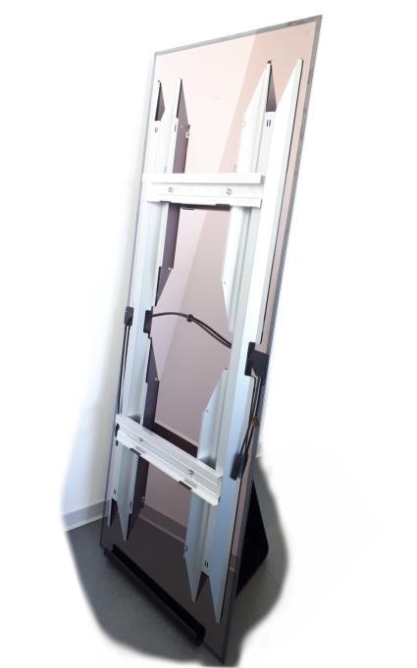
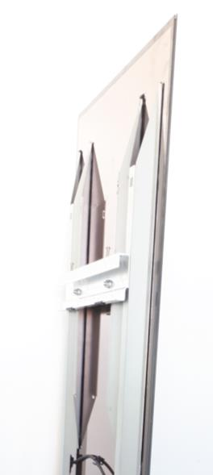
Solution with agraffes
Solution

Slide 11
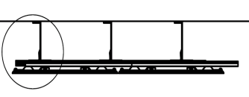
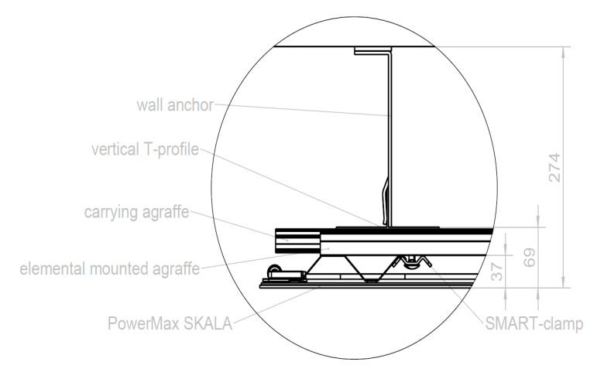
Example with agraffe from wagner system
Solution

Slide 12
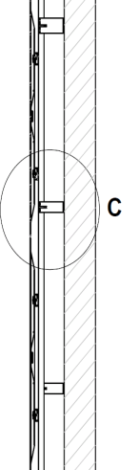
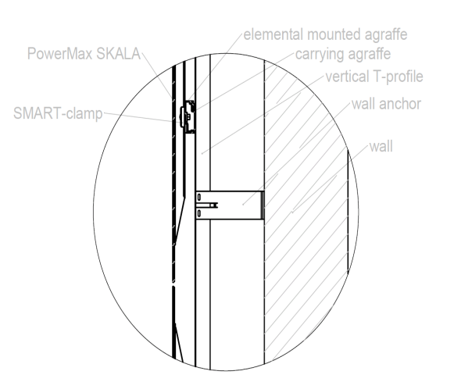
Example with agraffe from wagner system

Slide 13
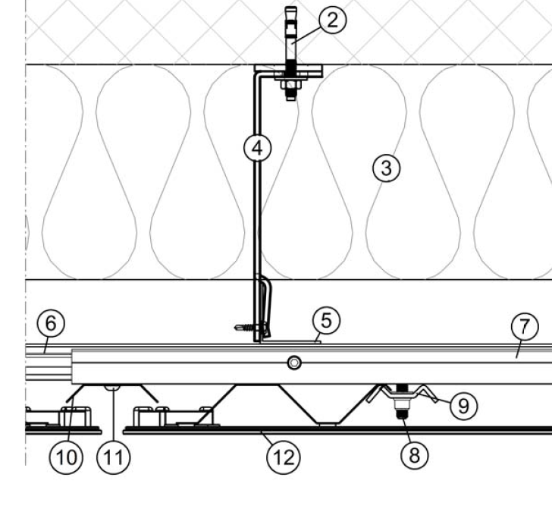
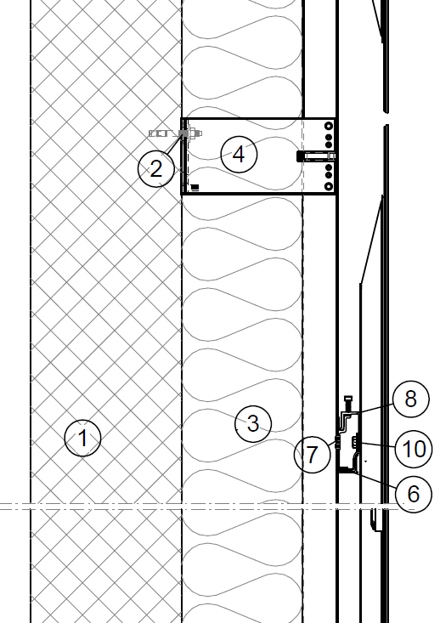

Slide 14
Example of Special projects solution
Solution

Slide 15
ECONOMICAL
INTEGRATION

Slide 16
“economical” INTEGRATION
A comparison beetween roof-top and solar façade systems
  Rooftop systems seem to be the cheaper and with the faster ROI.
  But in solar facades you have to calculate the anyhow costs, because you have to have a facade cladding material anyhow
  With this you may have an even better ROI with façade systems.
ROOF-TOP
FACADE
€
Years
Years

Slide 17
“economical” INTEGRATION
A comparison between classic façade and solar facade
Works | Avancis SKALA | Alucobond or Eternit
Ventilated Mounting System | 50,00 € | 50,00 €
Insulation | 30,00 € | 30,00 €
Mounting Cost Facade | 70,00 € | 70,00 €
Electrical Material and Mounting | 60,00 € | - €
Facade Material per sqm | 170,00 € | 110,00 €
Additional Contribution Margin | 40,00 € | 40,00 €
Cost per sqm | 420,00 € | 300,00 €
Gap | 120,00 €
Power Production | Avancis SKALA | Alucobond or Eternit
Facade Southeast (440 Panels, 464 sqm)
AEY per panel (equiv. 1,05 qm) in KWh | 88,86 | 0,00 | kWh/qm
Revenue per sqm per year (rated with 0,25 €/kWh) | 22,21 € | 0,00 €
Direct Payback on the "Anyhow"-cost in years | 5,4

Slide 18
Any relevant detail is solved > ready to be built!
ARCHITECTURAL/
ESTHETICAL
INTEGRATION
TECHNICAL
INTEGRATION
ECONOMICAL
INTEGRATION

Slide 19
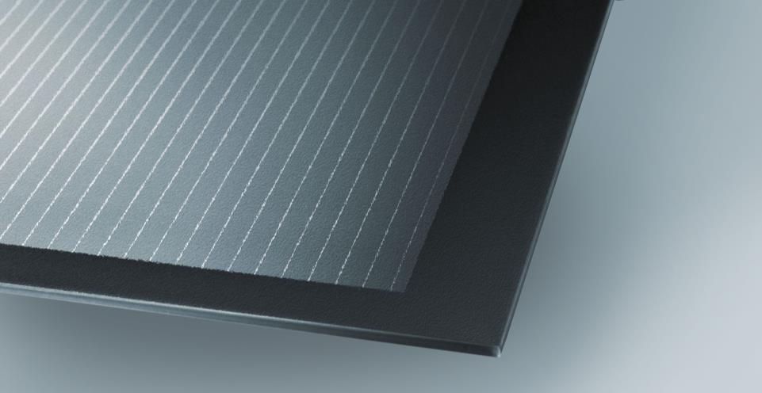
PROJECT EXAMPLES

Slide 20
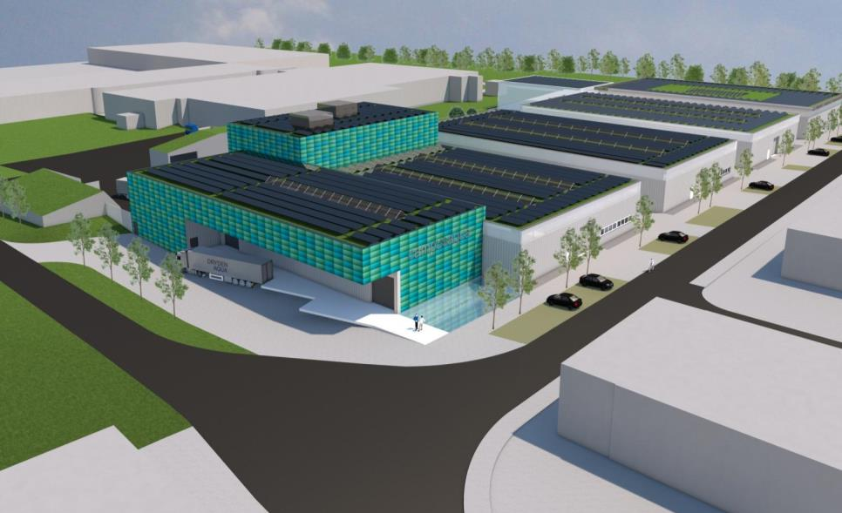

Slide 21
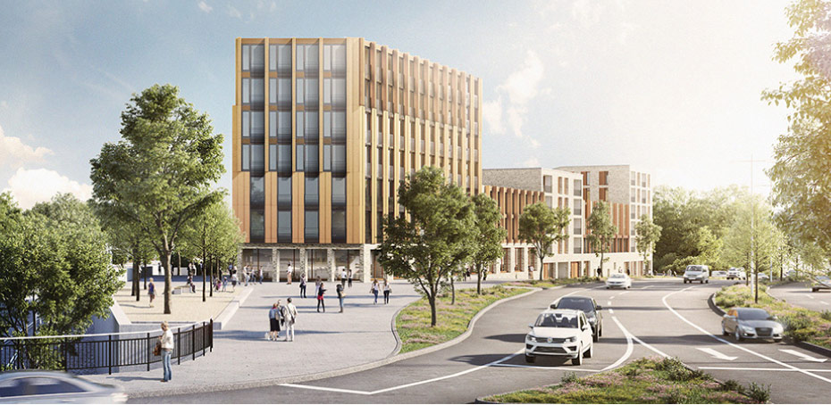
PROJEKTBEISPIELE
PROJEKT westspitze tübingen

Slide 22
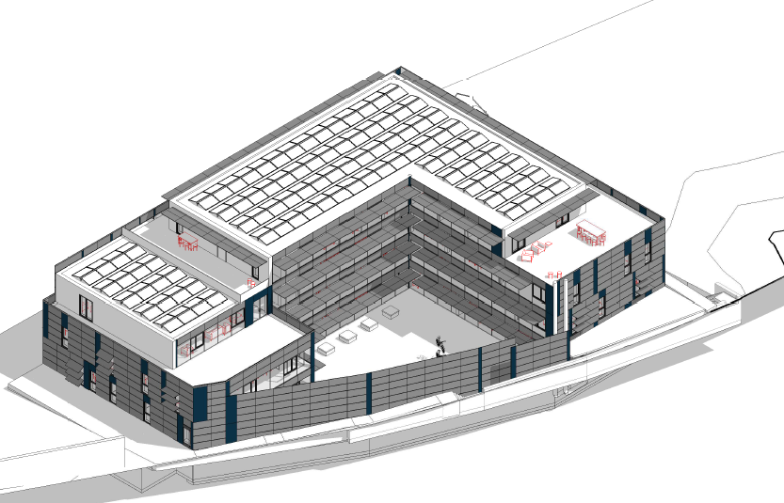

Slide 23
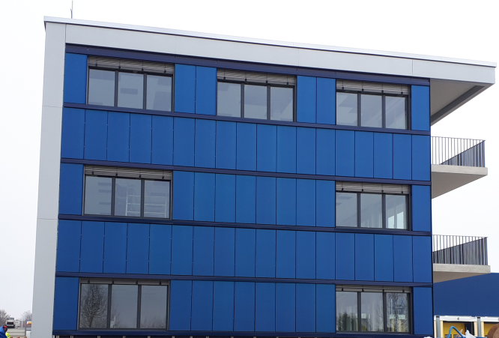

Slide 24
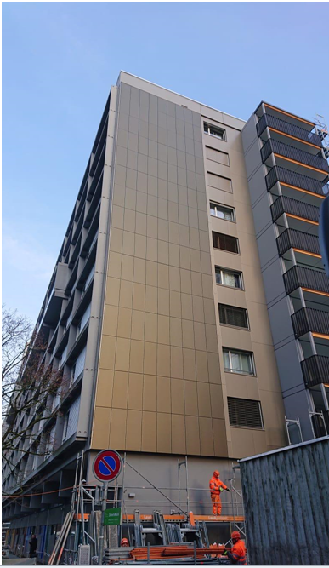
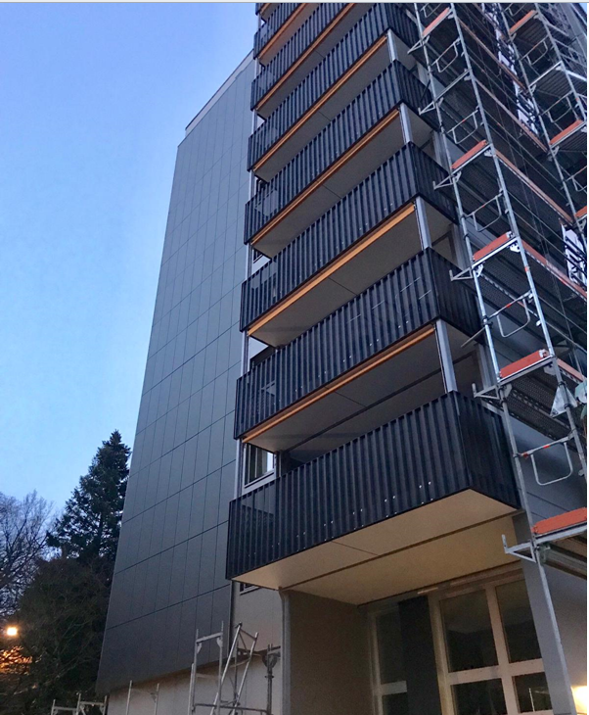
Bern, Melchiorstrasse

