Slide 2
A new dawn

Slide 3
Aiswei Cloud

Slide 4
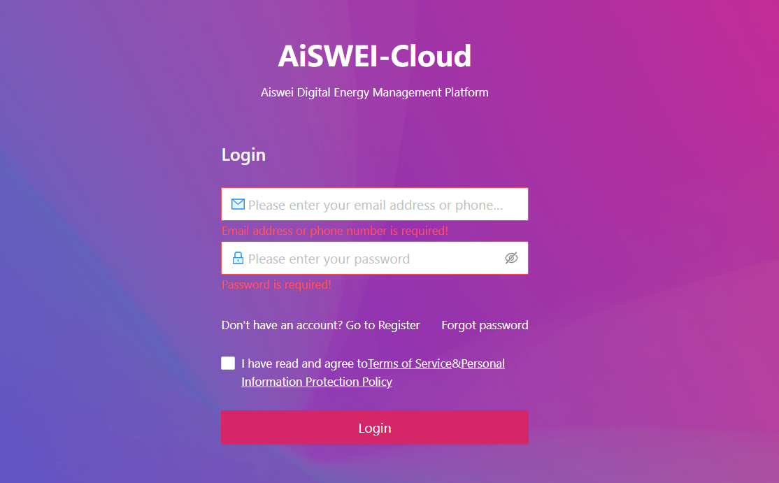
At a Glance
Web page „tool“ for installers
PC side operation
Main functions
Plant Overview Data View
Collector Batch Management
Inverter Batch Management
Management Organization
Create Plant
Warranty Inquiry
Plant Report Management
Web link: https://pro.aisweicloud.com/user/login

Slide 5
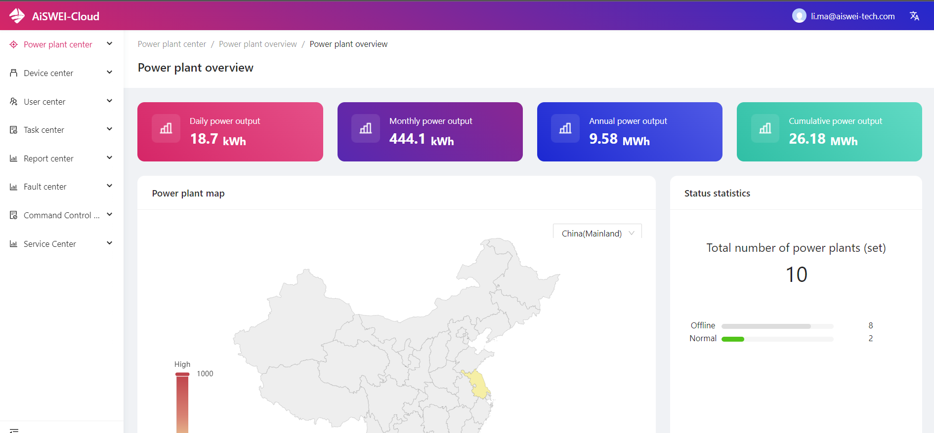
What is Aiswei Cloud
A smart device application for:
PV plant monitoring
PV plant set-up &commmissioning
Organizational management
Batch job

Slide 6
Who is it for?
Installers
Business users
In-company service personnel

Slide 7
Features

Slide 8
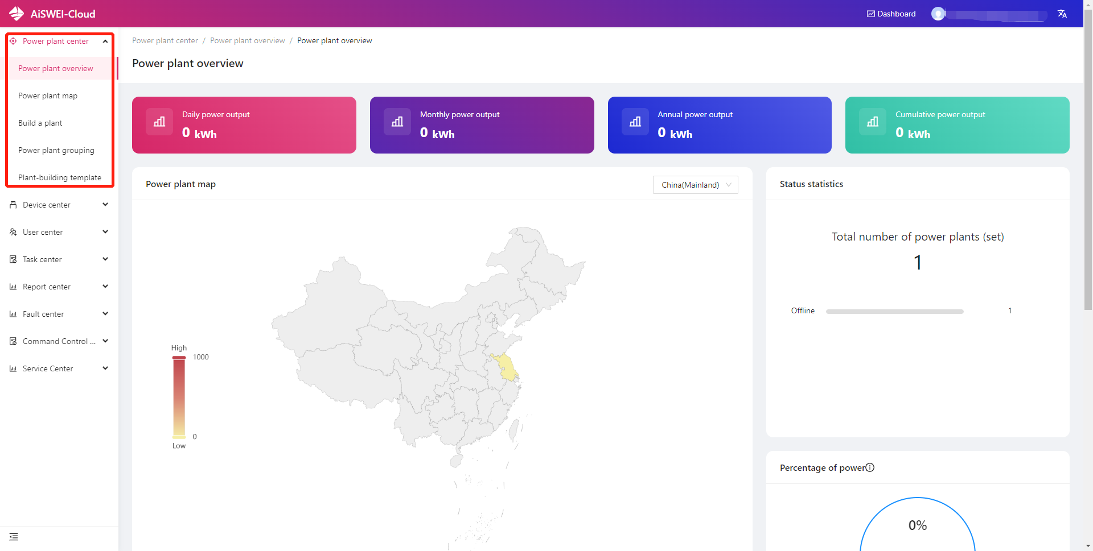
Power Plant Center
Power plant overview
View individual plant or overview all plant data
Power plant map
View your own power station on a map
Build a plant
Power plant grouping
Group power plants for unified management
Plant-building template
You can change owner/change O&M staff/ordinary share/batch download plants below you.

Slide 9
Power plant list
Check the plants
Click change owner/change O&M staff/ordinary share
Enter the account(phone number or email address)
Change owner: only end user
Change O&M staff: only business account in your organization
Ordinary share: only end user

Slide 10
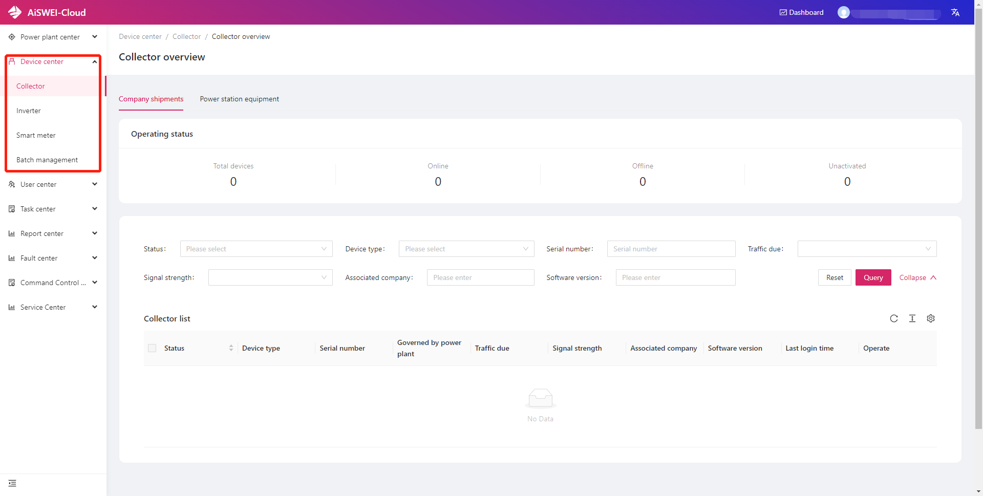
Device Center
Collector
Unbundling with power station and query of basic information
Inverter
Download the specified inverter report
Set parameters remotely
Specify the corresponding fault query of the inverter
Smart meter
Basic information query
Batch management
Batch download basic information of collectors and inverters

Slide 11
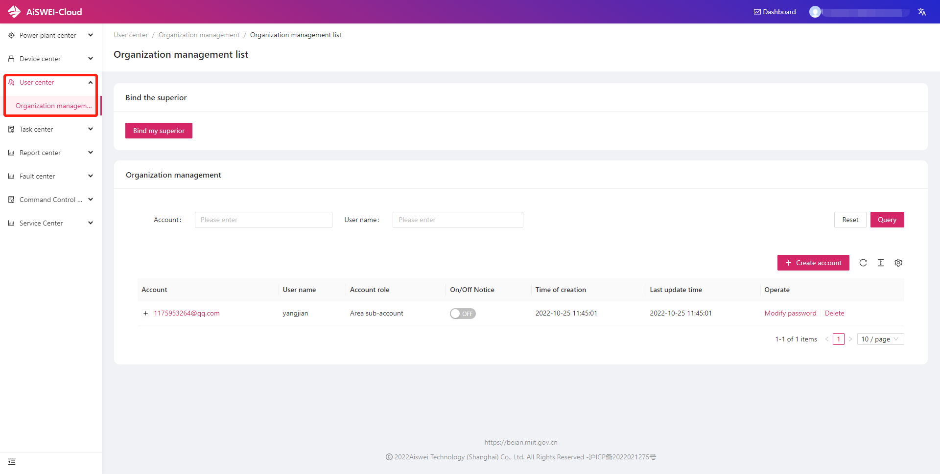
User Center
Organizational management
You can manage your subordinate accounts through this portal
Create an account
Change password
Delete account

Slide 12
Organizational management
Main account
First level
The business account registered directly in Aiswei Cloud is Main account.
The business account created by Main account in organizational management is Area sub-account.
The business account created by Area sub-account in organizational management is O&M sub-account.
An organization can only have three levels at most.
All accounts at each level can create View sub-account, which can only view the plan.
Area sub-account
Second level
O&M sub-account
Third level

Slide 13
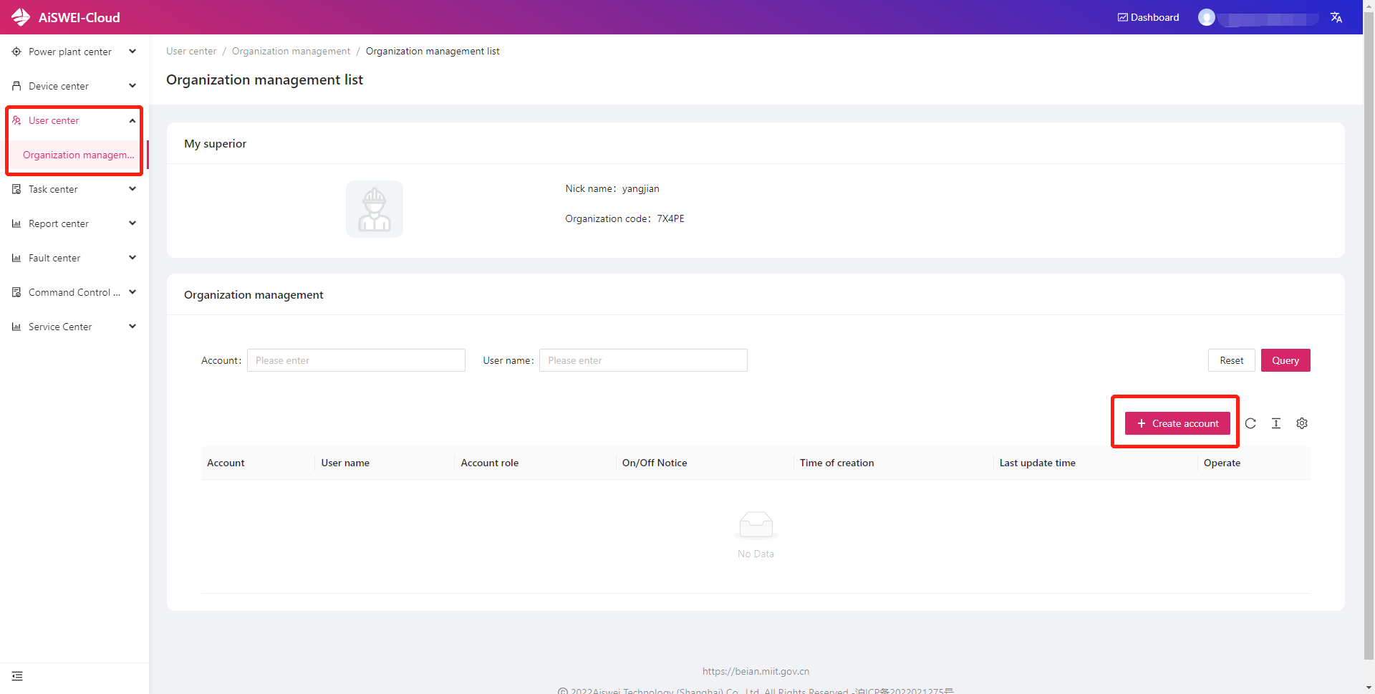
A superior account can create multiple subordinate accounts.
The superior account can view and manage plants of subordinate accounts.
The plants of the superior account can be assigned to the subordinate account to manage. But one plant can only be assigned to one subordinate account.

Slide 14
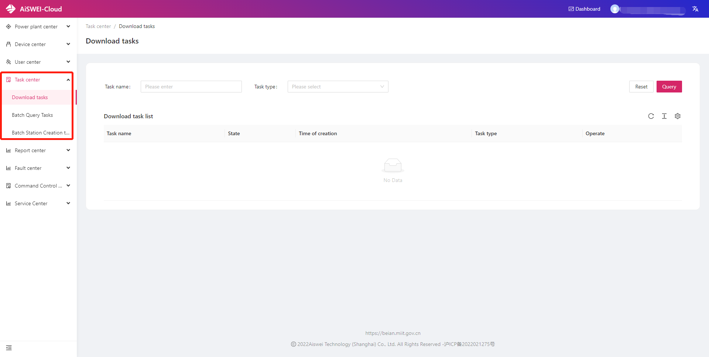
Task center
Download task management
All downloaded content needs to be exported here

Slide 15
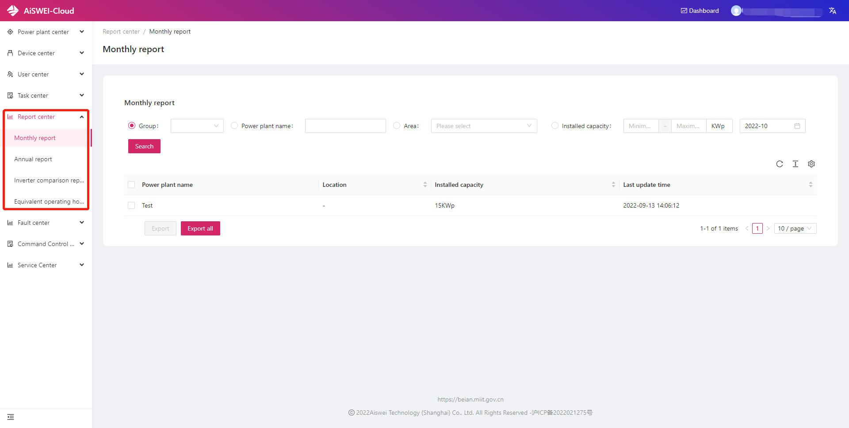
Report Center
Monthly Report
The power station can be specified, and the monthly data table of the selected power station can be exported
Annual Report
The power station can be specified, and annual data table of selected power station can be exported
Inverter Comparison Report
The comparison report of the specified parameters can be carried out from the power station, the collector or the specified inverter serial number
Equivalent Hours Report
Export a report of equivalent hours for a specified inverter

Slide 16
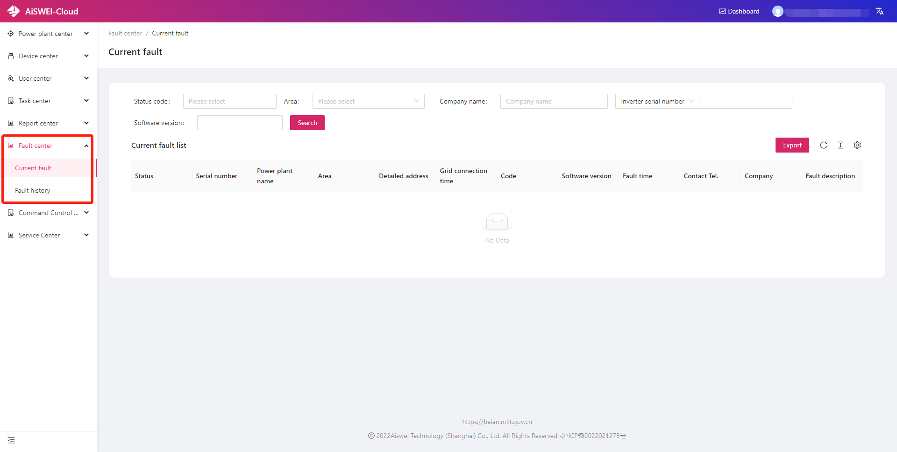
Fault Center
The power plants under the name can be viewed from the two dimensions of current faults and historical faults

Slide 17
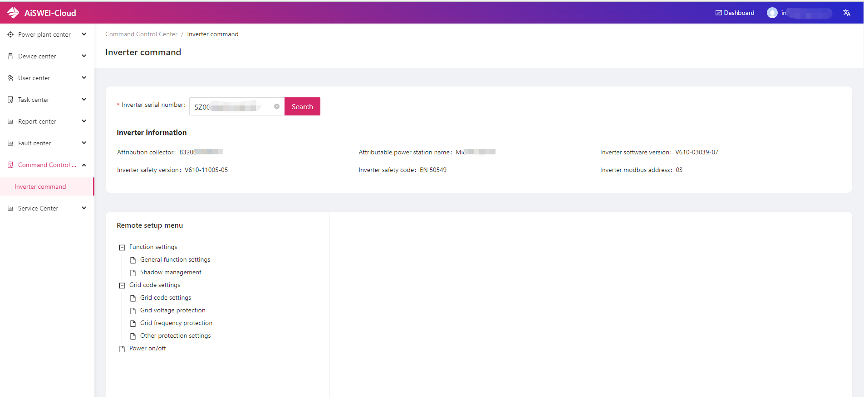
Command Control
Center
You can remotely set the inverter parameters under your own name by specifying the inverter serial number

Slide 18
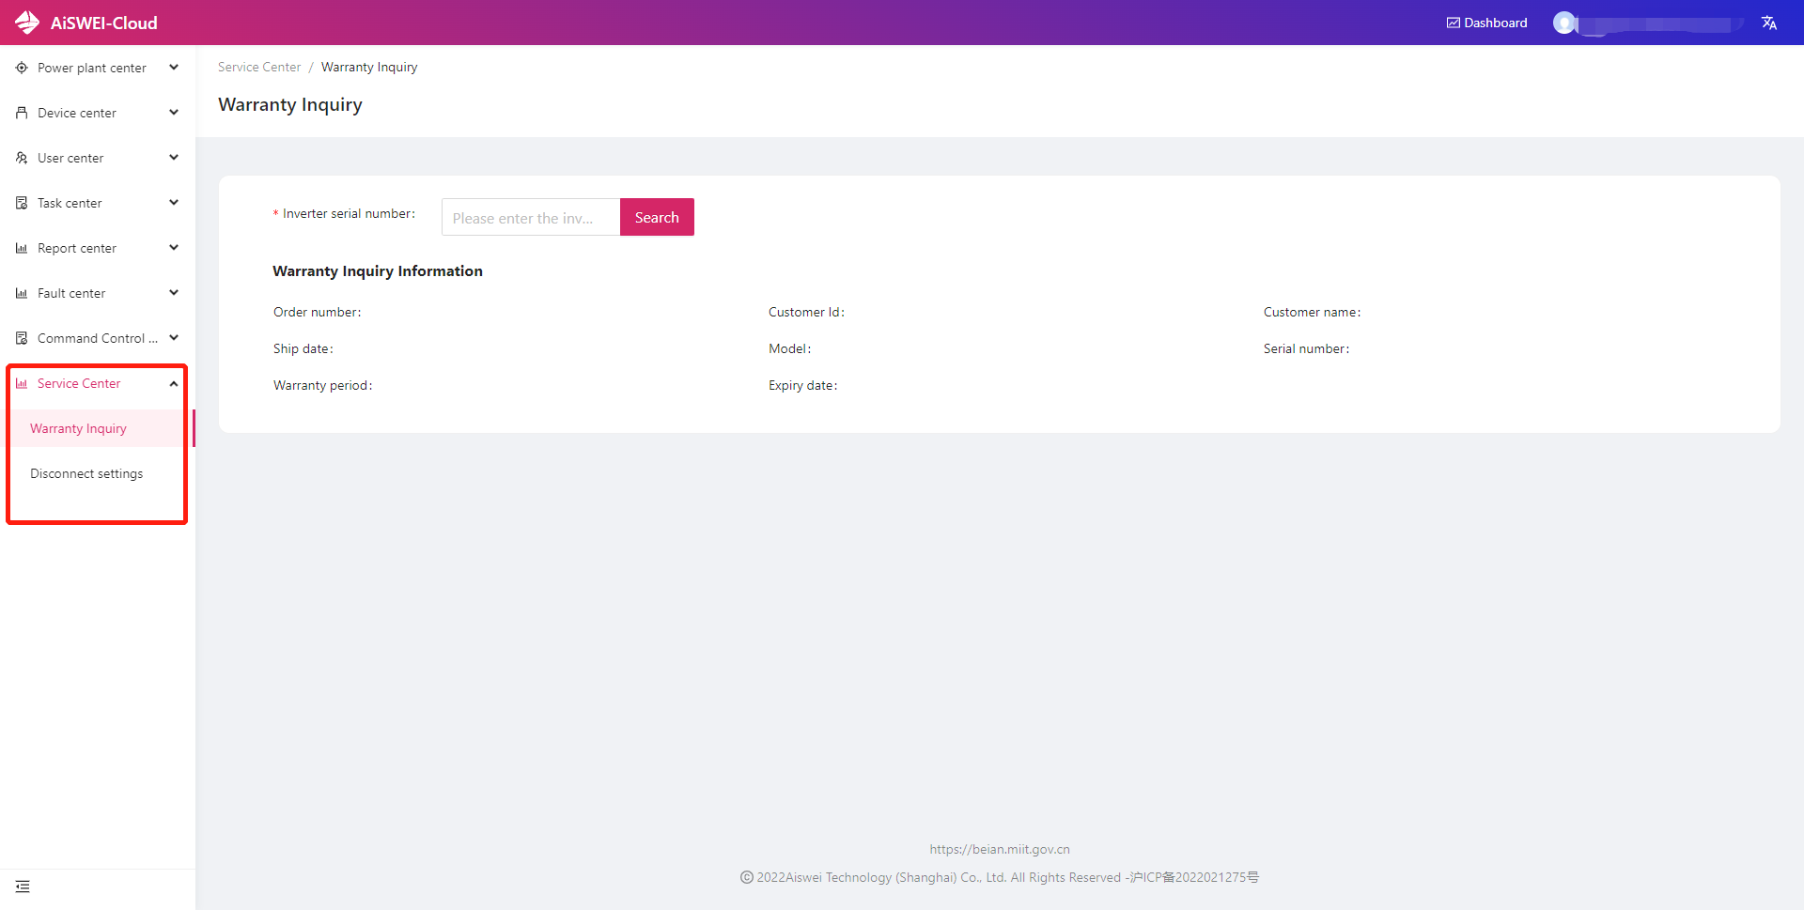
Service Center
Warranty Inquiry
Check warranty by inverter serial number
Disconnect settings
Turn on and off disconnect notification

