Slide 2
A new dawn

Slide 3
Solplanet APP

Slide 4
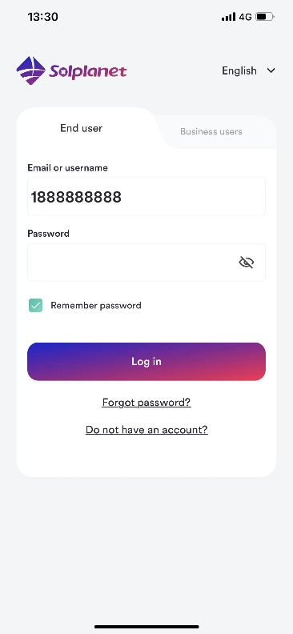
At a Glance
App „tool“ for installers/end users
iOS and Android
Main functions
Create PV plant
Commissioning
Grid code
Export Power Limit
Active/reactive power modes
Shadow management
AFCI
PV plant sharing
Data migration
Modify parameters remotely

Slide 5
What is Solplanet
A smart device application for:
PV plant monitoring
PV plant set-up & commmissioning

Slide 6
Who is it for?
Installers
End users

Slide 7
Monitoring

Slide 8
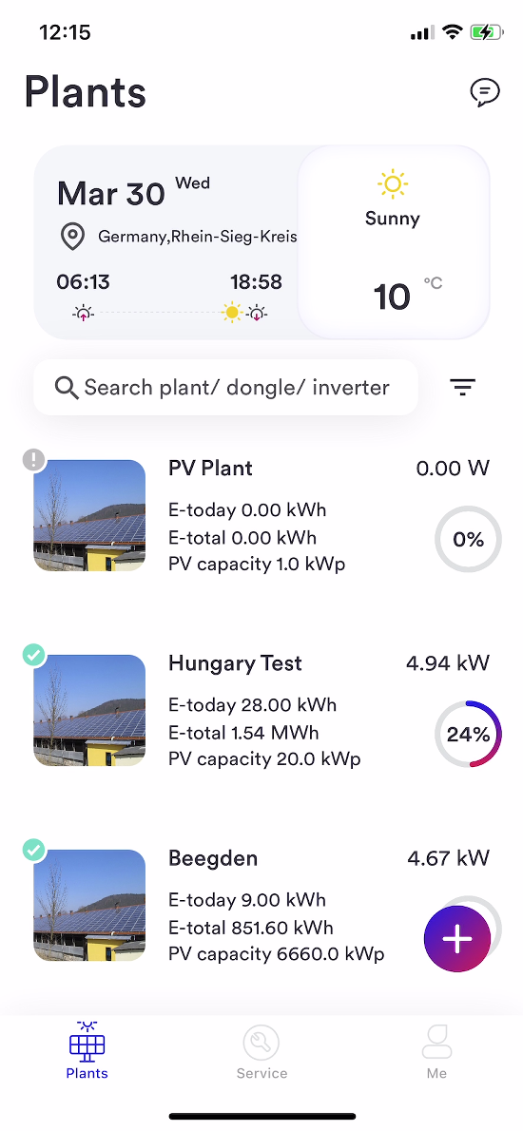
Plant List
List of all PV plants under management regardless of status

Slide 9
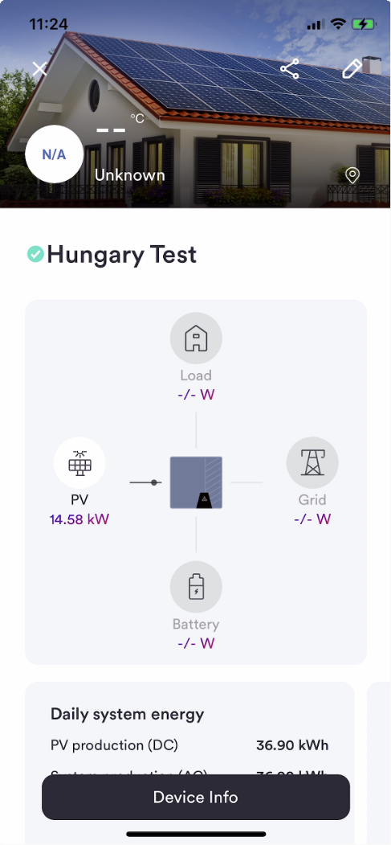
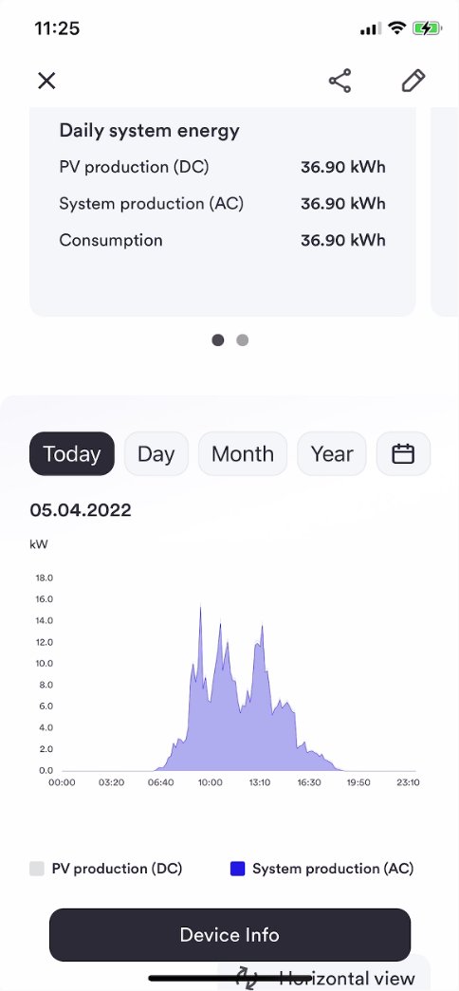
PV Plant Data
Grid connect inverter with NO energy meter
Current power production
Daily system energy
Daily savings
Daily generation graph
Day, month, year bar graph
Weather

Slide 10
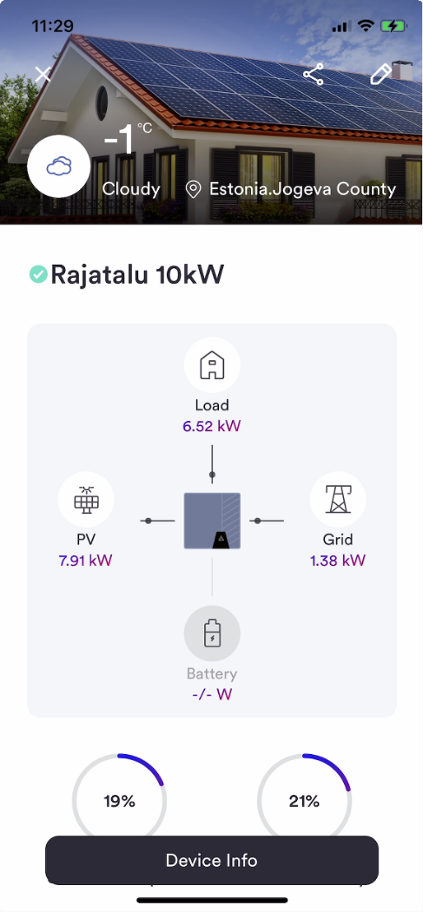
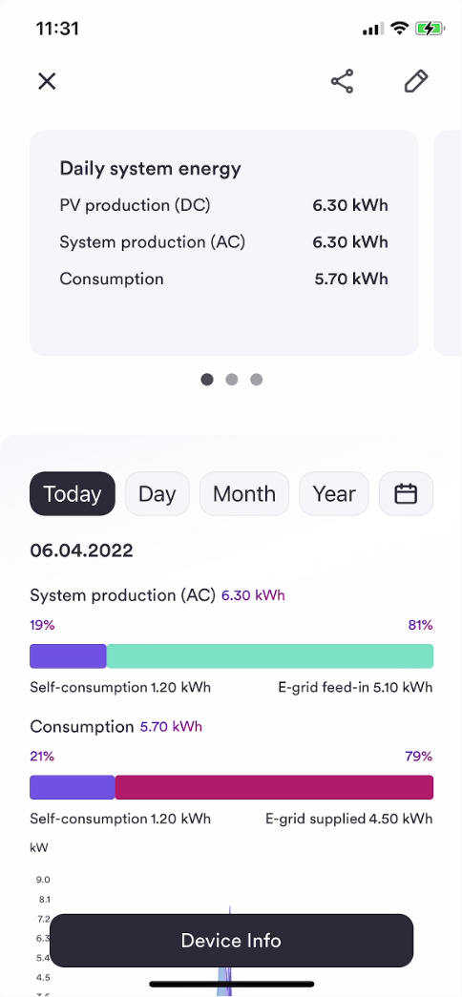
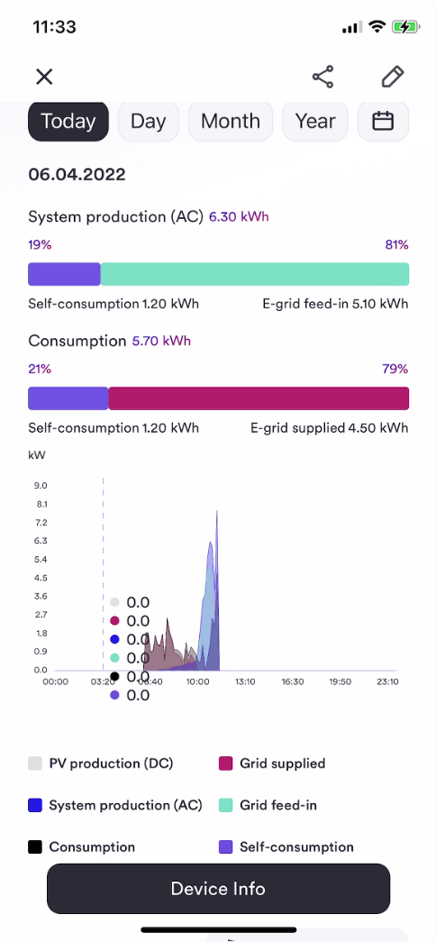
PV Plant Data
Grid connect inverter with energy meter
Self consumption %
Self sufficiency %
Current power production
Current load consumption
Current grid import/export
Daily system energy
PV production (DC)
System production (AC)
Consumption
Self-consumed
Grid-supplied
Grid feed-in
Daily savings
Daily generation graph
Day, month, year bar graph
Weather

Slide 11
PV Plant Data
Hybrid inverter
All data as per grid connect with meter
Battery info
SOC
Charge
Discharge

Slide 12
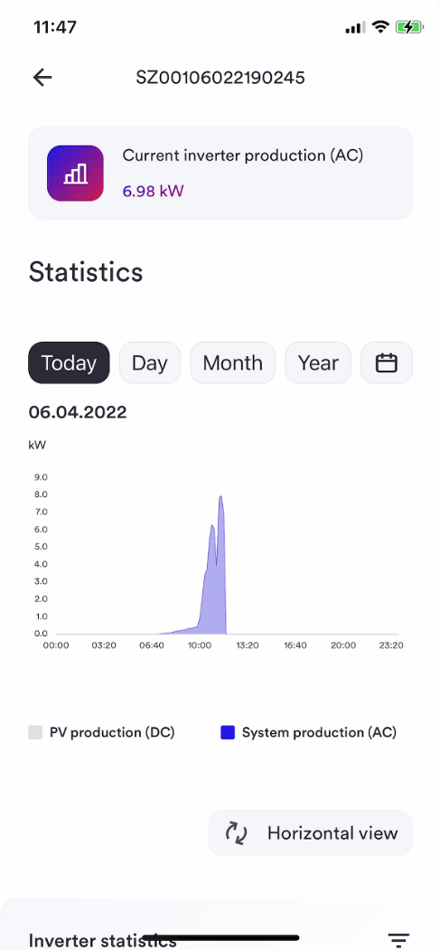
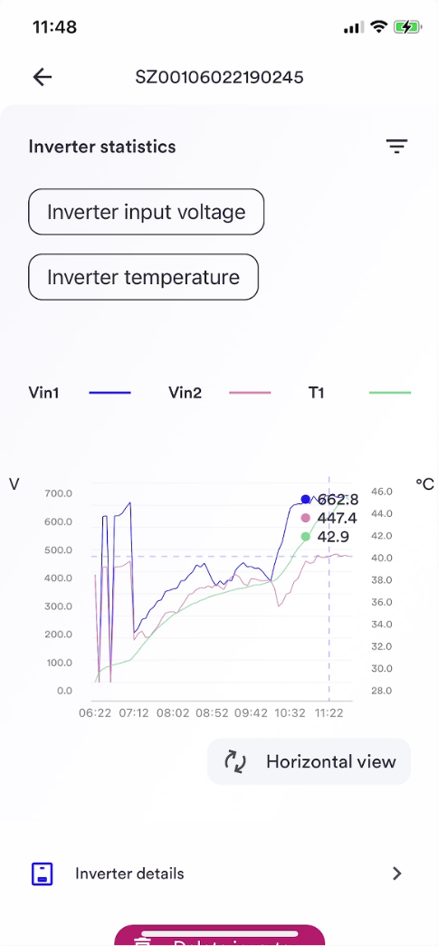
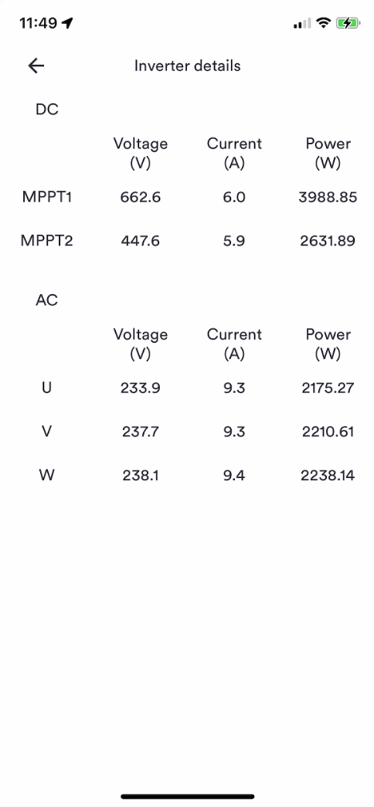
Inverter Data
DC input string voltage/current/power
AC voltage/current/frequency/power
Temperature

Slide 13
Features

Slide 14
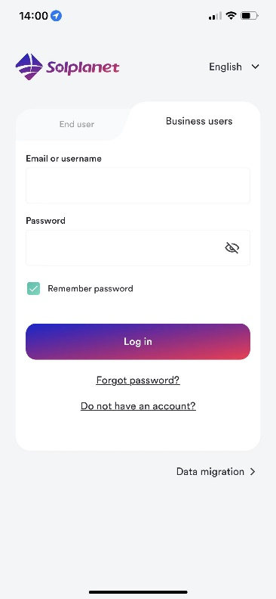
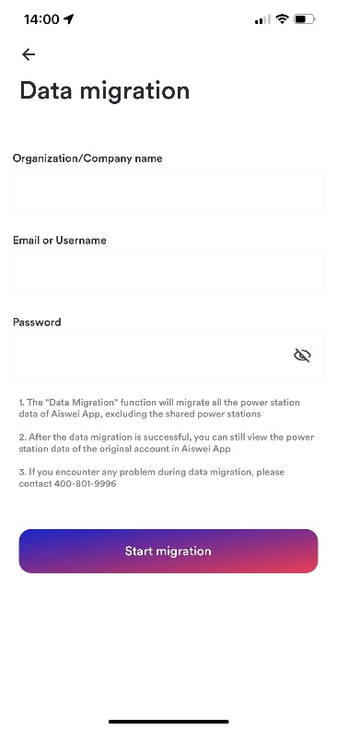
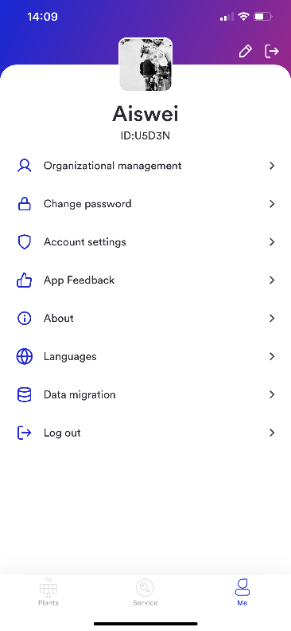
Data migration
This function is used for customers in the Aiswei application to upgrade to enterprise users of the Solpalnet application, and at the same time copy all the power station information under the customer account in the Aiswei application to the Solplanet application.
End users in the Aiswei app do not need to perform data migration and can log in directly with their Aiswei account.
Once you use the data migration feature, you will be upgraded to a business user
Select the "Data Migration" entry, and enter your Aiswei App account, password and your company name to complete the migration

Slide 15
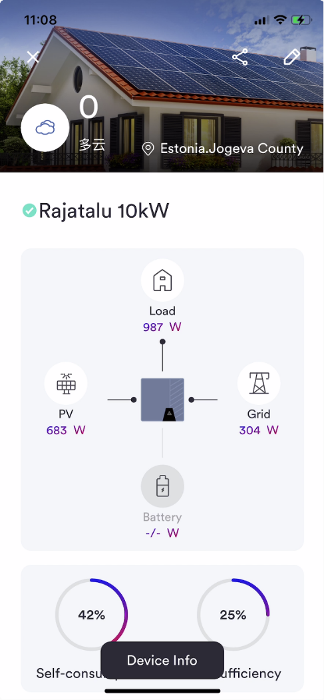
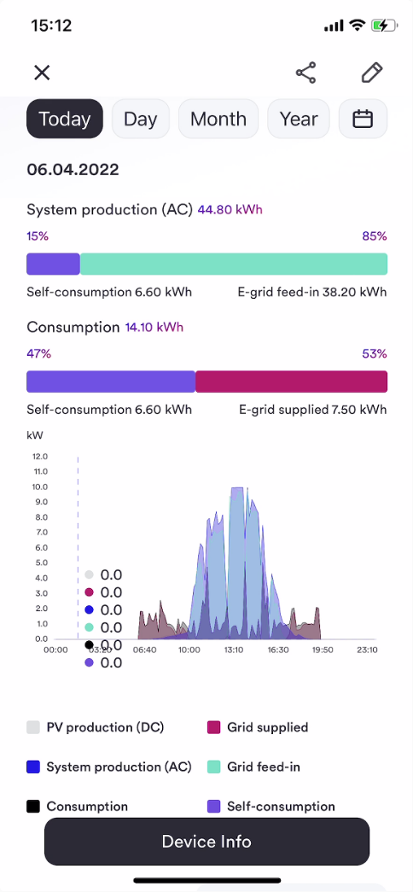
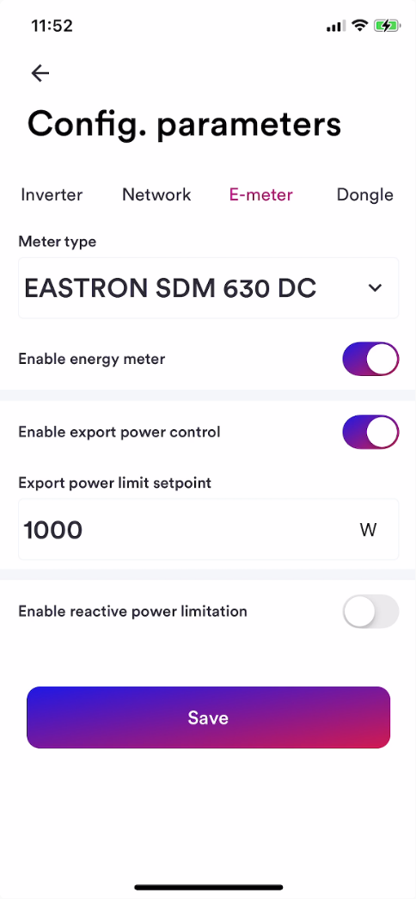
Consumption monitoring & export power control
Energy meter selection
Export power control setup
Active power limitation
Reactive power limitation

Slide 16
Consumption monitoring & export power control
Energy meter selection
Export power control setup
Active power limitation
Reactive power limitation

Slide 17
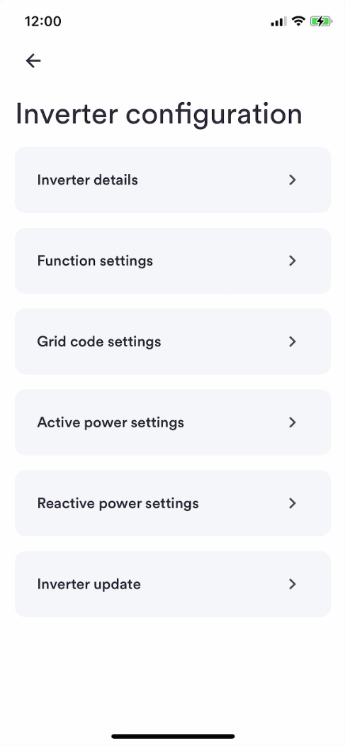
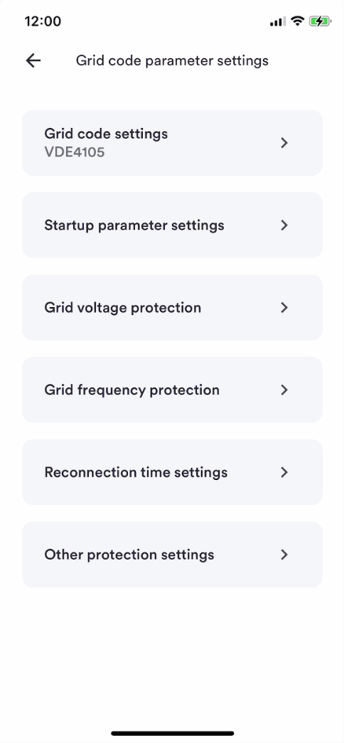
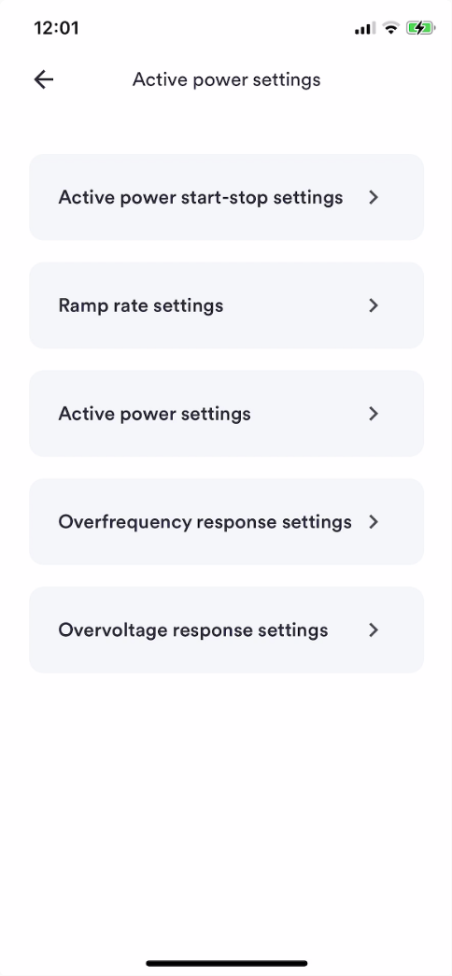
Inverter configuration
Grid code selection
Grid code parameter adjustments
Active power settings
Reactive power settings
Fixed power factor
Fixed Q
Cosφ(P)
Q(U)

Slide 18
Inverter near field configuration
Grid code selection
Grid code parameter adjustments
Active power settings
Reactive power settings
Fixed power factor
Fixed Q
Cosφ(P)
Q(U)

Slide 19
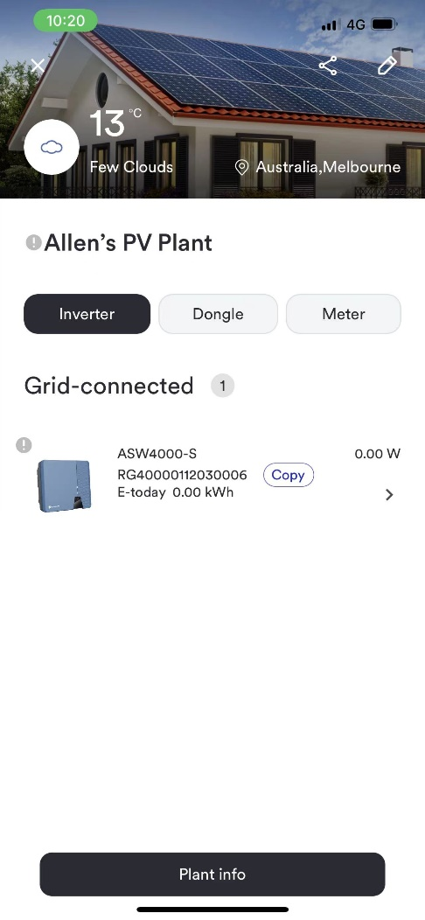
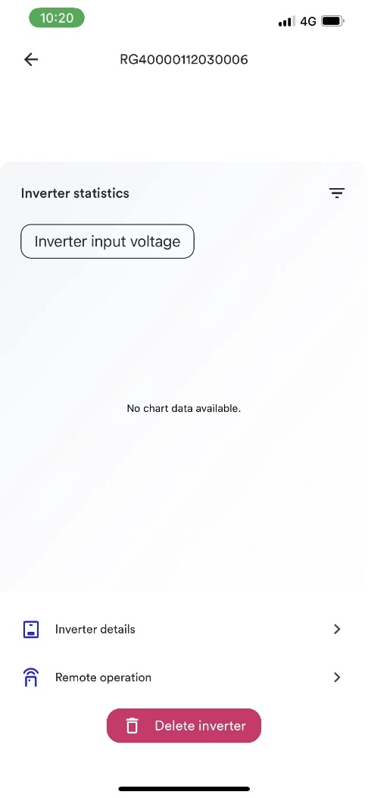
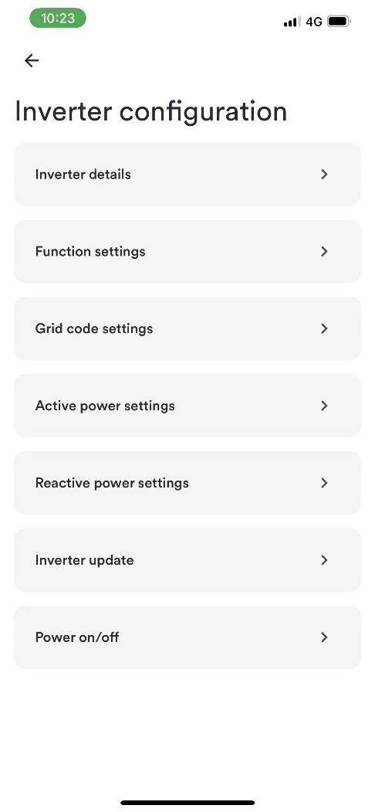
Inverter remote configuration
Almost all parameters of near field configuration can be configured remotely
What is remote configuration?
Unlike near-field configuration, parameters can be configured while the device is connected to the network, even if you are not next to the machine.

Slide 20
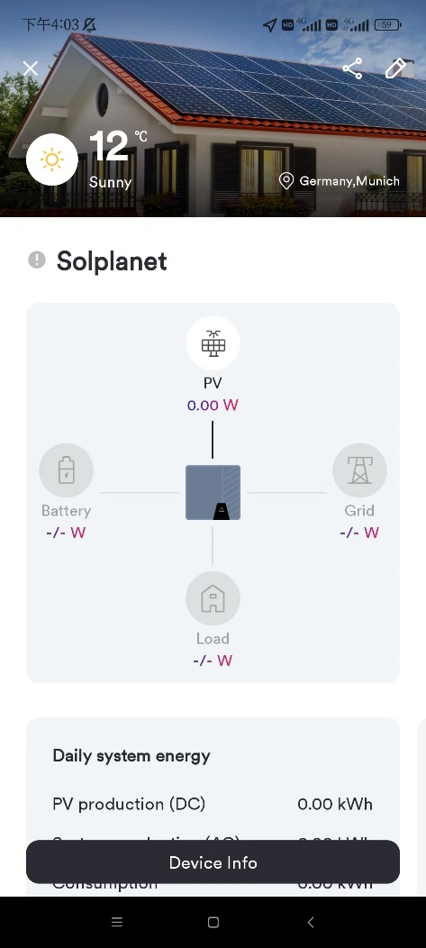
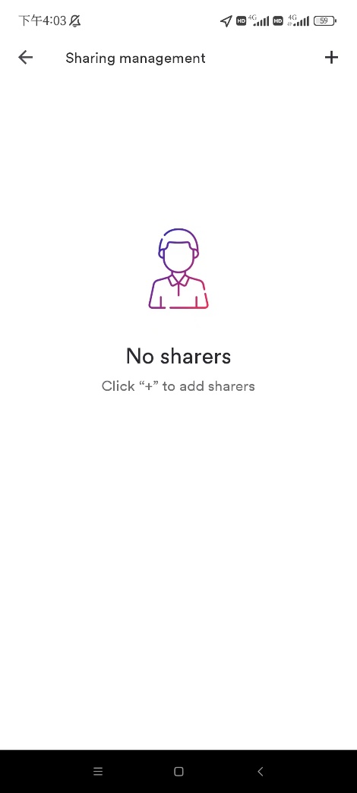
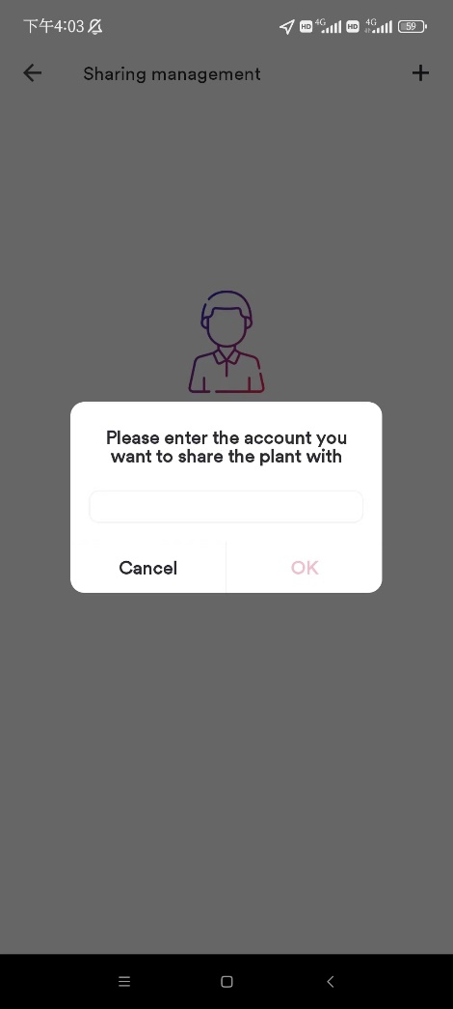
Plant sharing
The plant can only be shared with end users
A plant can be shared with multiple end users, but it can be bound to only one business user.
The shared user can only view the plant and cannot configure the plant

Slide 21
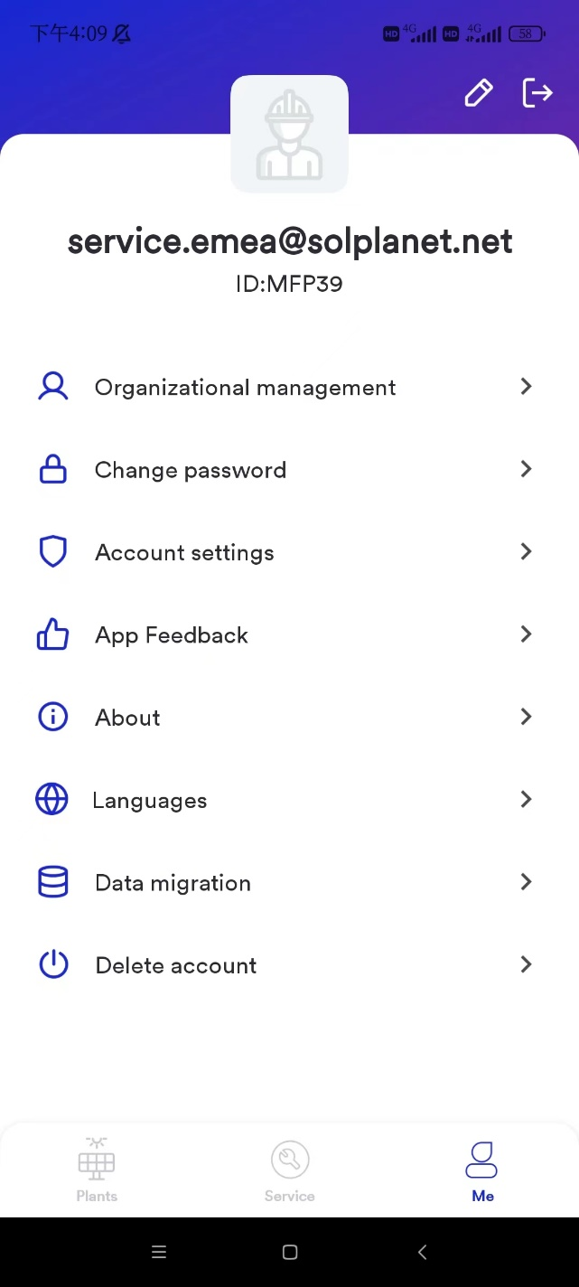
Bind a business user
Every business user has a unique ID (organization code)
If you want to bind a plant to a business user, please get the organization code first.

Slide 22
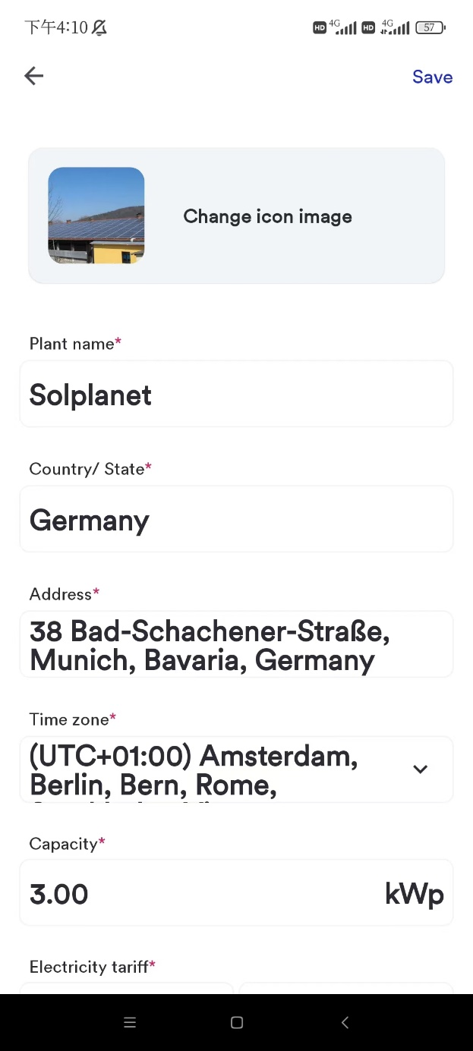
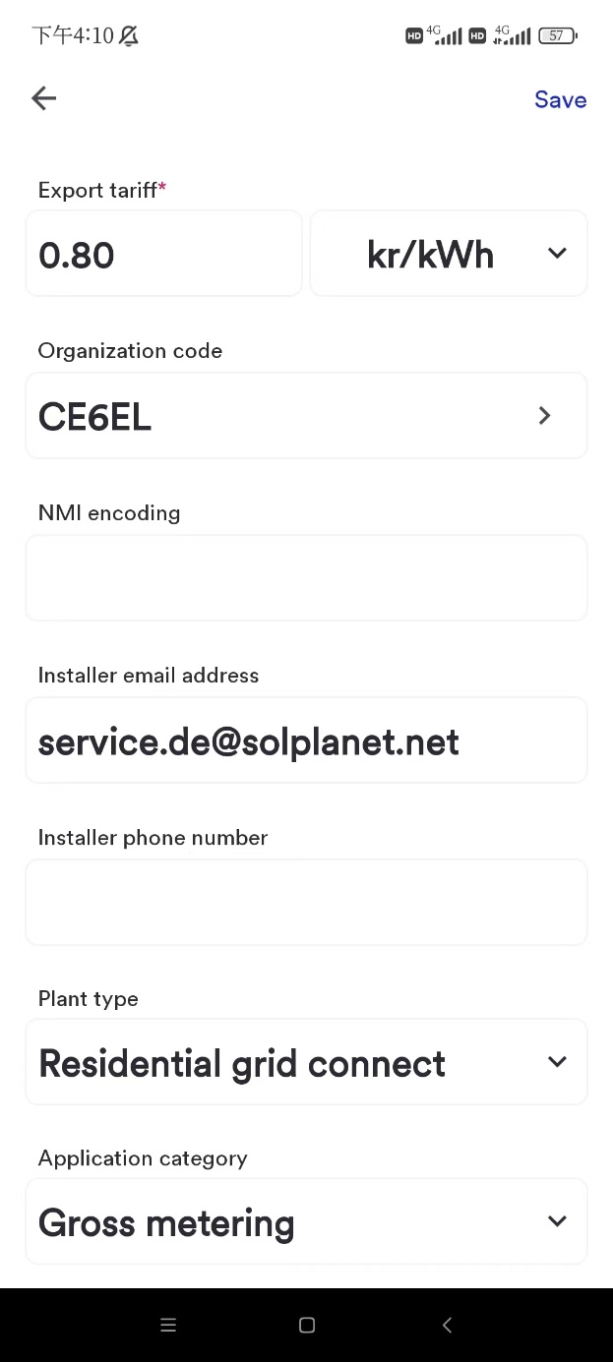

Slide 23
Simple Steps

Slide 24
Create
Enter SN/Reg
Set-up
Grid code
Success!
Plant Created
Internet connection established
Enter plant details
Scan QR code
Export power
Power modes
WiFi
Process

Slide 25
Set-up & commissioning

Slide 26
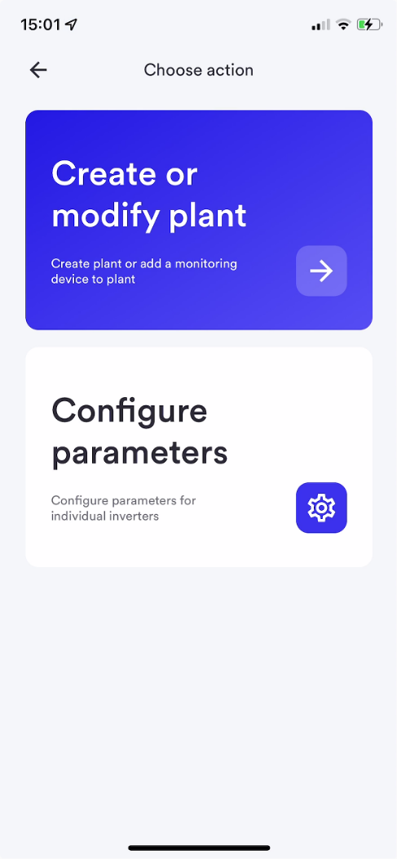
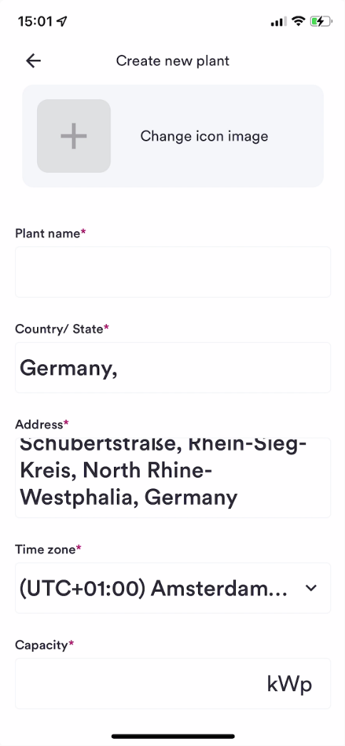
PV plant creation
Current power production
Current load consumption
Current grid import/export
Daily system energy
Daily savings
Daily generation graph
Day, month, year bar graph
Weather

Slide 27
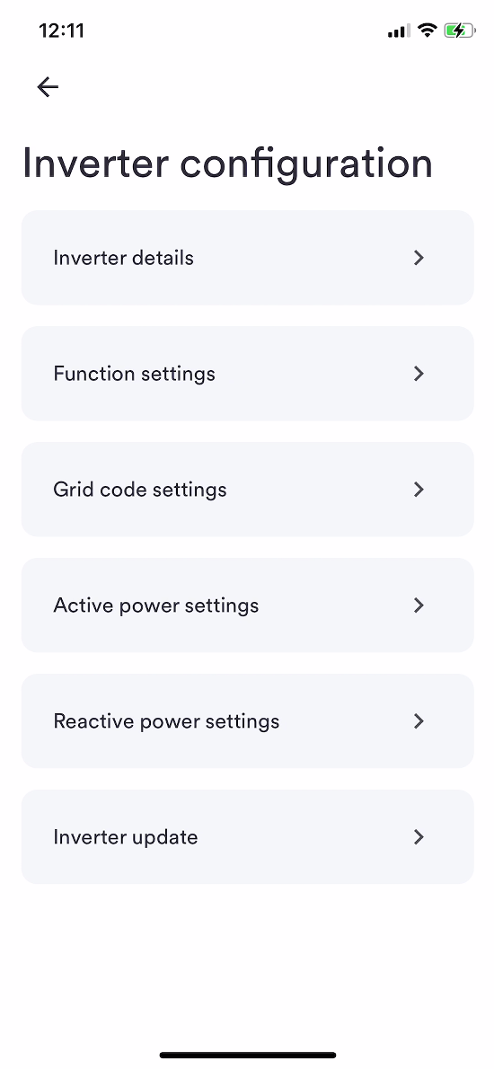
Inverter configuration
Grid code selection
Grid code parameter adjustments
Active power settings
Reactive power settings
Fixed power factor
Fixed Q
Cosφ(P)
Q(U)

Slide 28
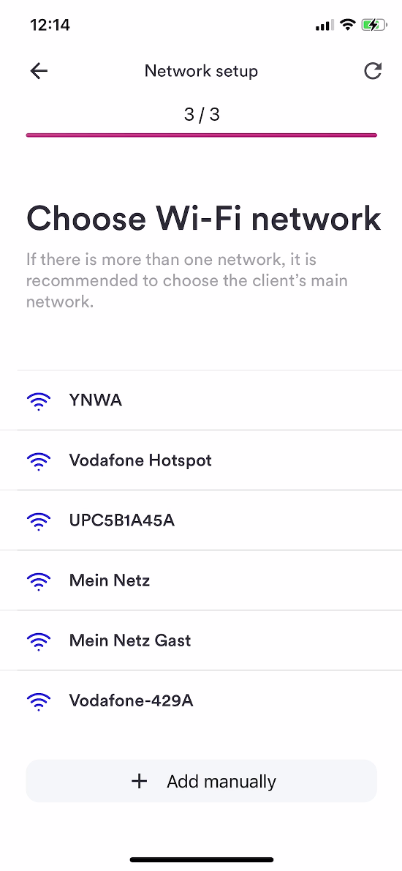
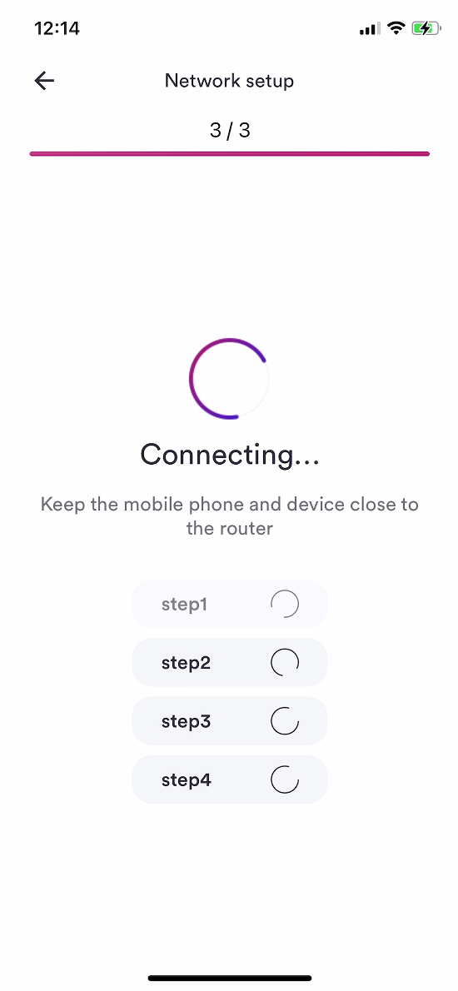
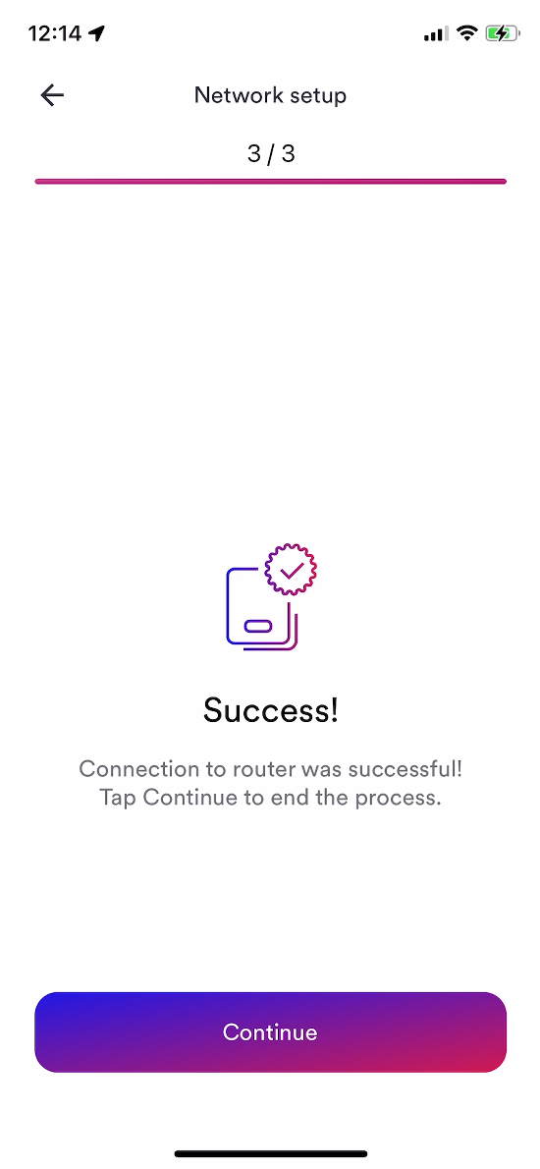
Wi-Fi Set-up
Simple WiFi set-up
First time commissioning or post commissioning

Slide 29
Update

Slide 30
Update
The Future
Final release - imminent
Creating a Power Station - A Beginner's Guide
Power generation calibration
Account cancellation function

Slide 31
Business & End user

Slide 32
End user
Business user
for end user
website: https://www.aisweicloud.com/
without ID (organization code)
cannot configure inverter remotely
with options in inverter configuration in local mode:
a. Inverter details
b. Inverter update
c. Power on/off
without organizational management
for installers
website: https://pro.aisweicloud.com/
with a unique ID (organization code)
can configure inverter remotely
with all options in inverter configuration in local mode
with organizational management
Note: the plant can only be shared with end users, not business users.

Slide 33
organizational management

Slide 34
Main account
The business account registered directly on APP is main account.
The business account added by main account in organizational management is regional account.
The business account added by Regional account in organizational management is OPS installer.
An organization can only have three levels at most.
First level
Regional account
Second level
OPS Installer
Third level

Slide 35
A superior account can create multiple subordinate accounts.
The superior account can view and manage plants of subordinate accounts.
The plants of the superior account can be assigned to the subordinate account to manage. But one plant can only be assigned to one subordinate account.

